Slide 1


Slide 2
Why Premiere League ?
Football has become a religion, the necessity to enhance the game, skills and the whole entertainment business has become utterly important.
As managers have ceased to rely on gut alone, clubs have started investing their fortune in data Analytics companies for smart use of their tactics by gauging the attacking and defensive patterns of respective opponent or for improving their own potential.
There are also various product companies that rely on such data to increase sales of their product.For such advance sports analytics, comes the demand for a highly structured data warehouse which can collate all the necessary data available for further processing.

Slide 3
GOALS
1. MANAGER
Does managerial impact influence club results ?
2. REFEREE
Can a single wrong decision of referee spoil entire game ?
3.TEAM
Can analyzing opponents help in winning games ?

Slide 4
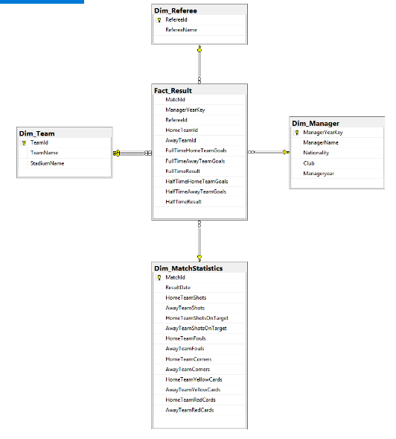
DATABASE DIAGRAM

Slide 5
ETL PROCESS

Slide 6
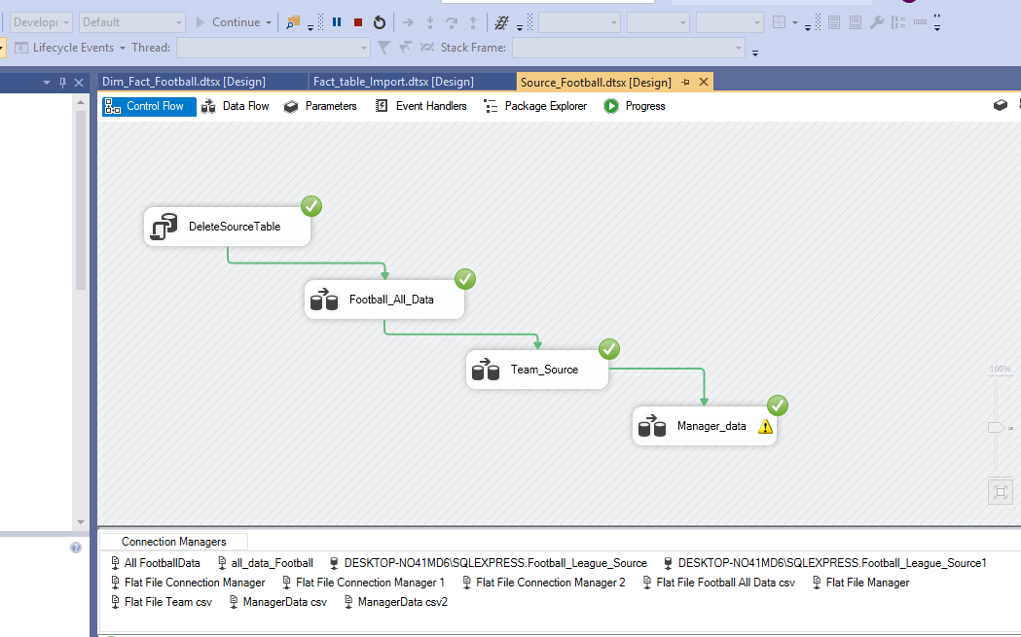
The data is extracted from 3 different data sources. Those 3 Data sets then Loaded into Source tables from SSIS Tool .

Slide 7
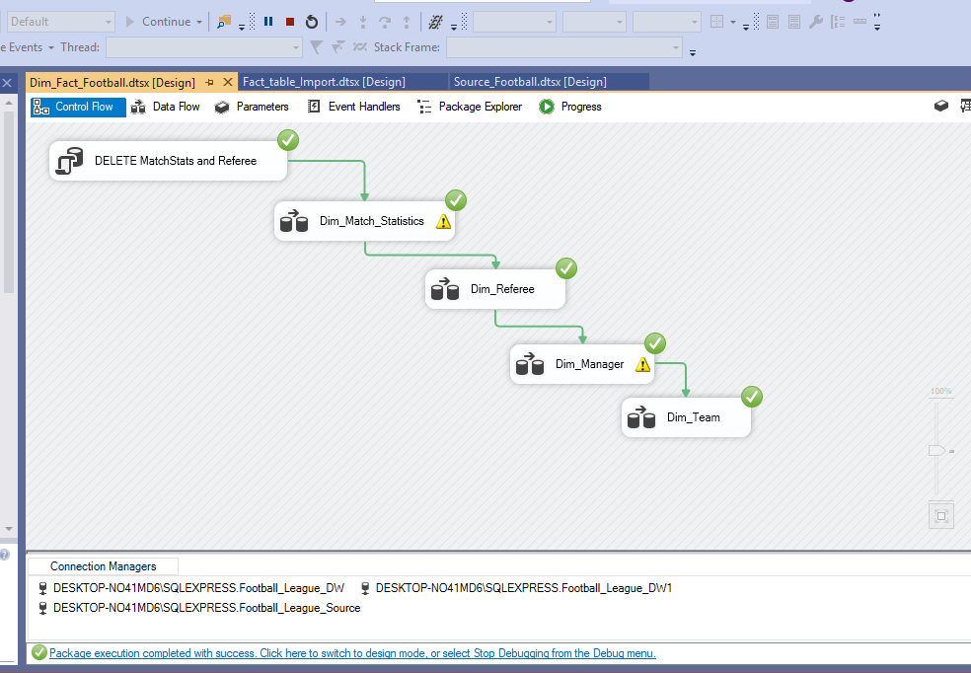

Slide 8
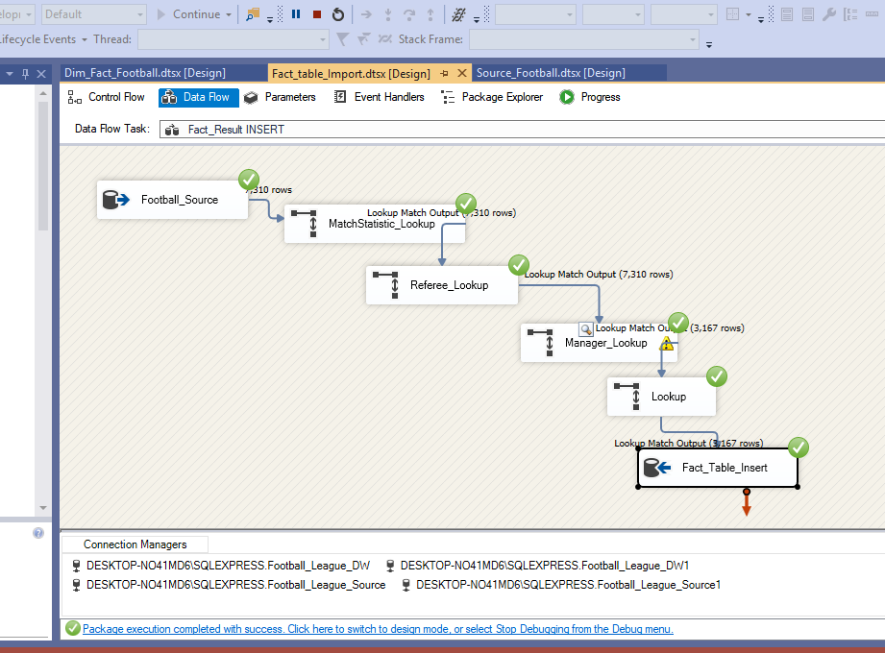

Slide 9
SSRS REPORTS

Slide 10
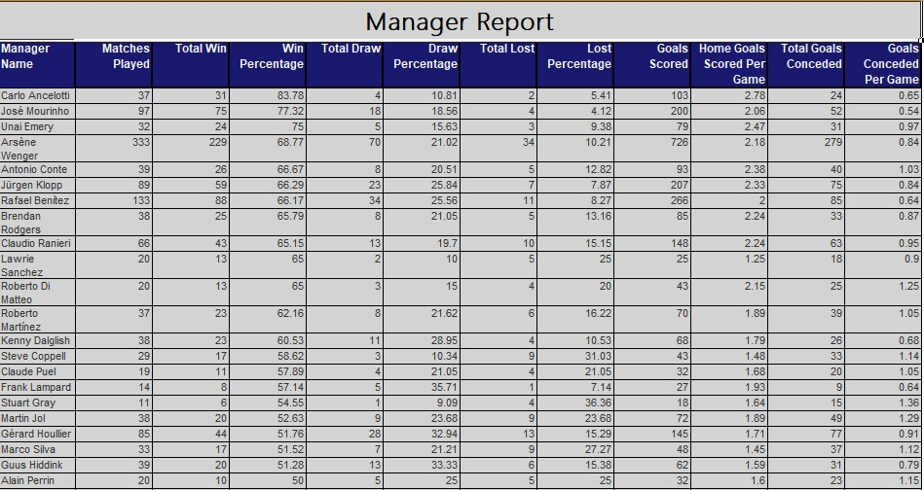

Slide 11
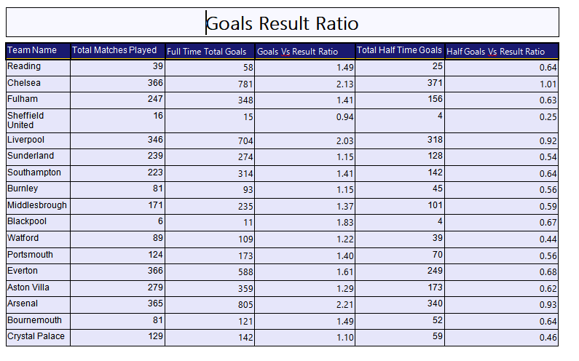

Slide 12
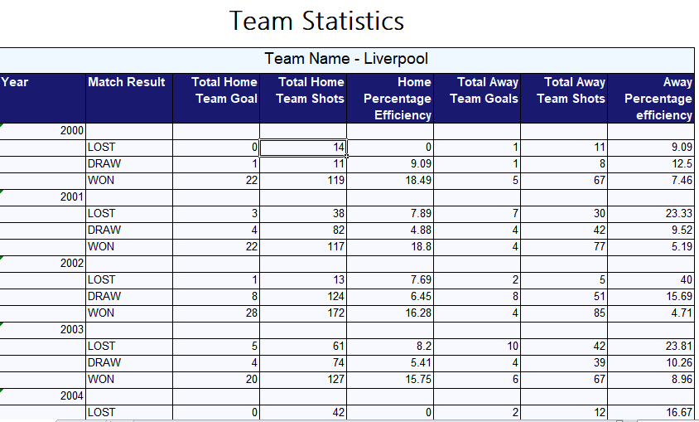

Slide 13
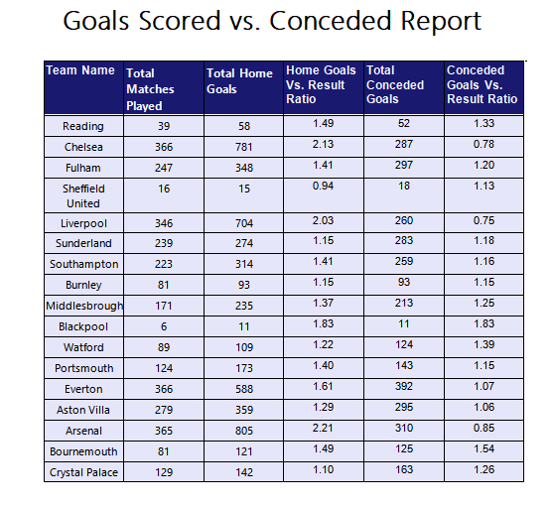

Slide 14
R - VISUALIZATION

Slide 15
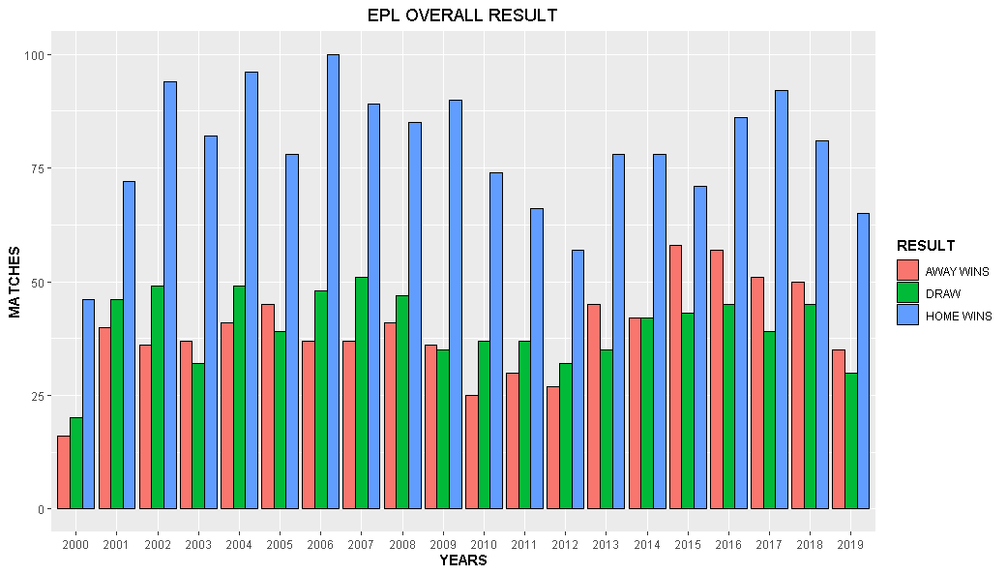
EPL OVERALL RESULT

Slide 16
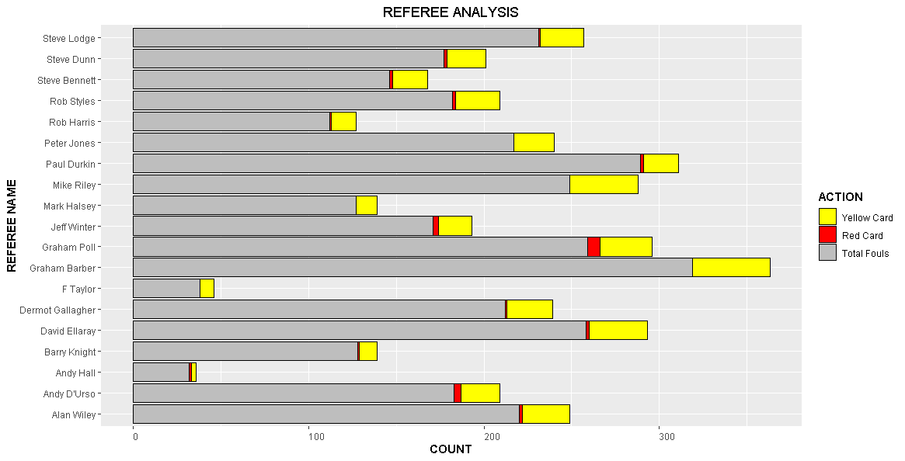
PERFORMANCE OF REFEREE

Slide 17
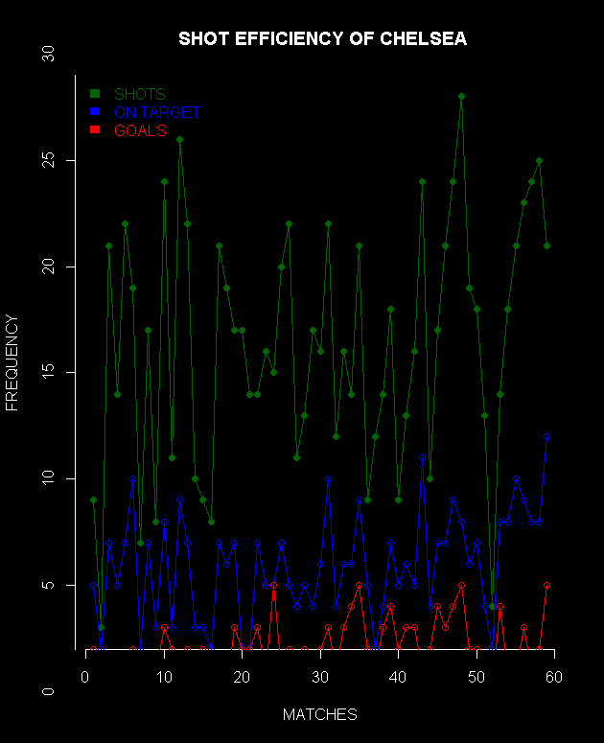
ANALYZING SHOT EFFICIENCY

Slide 18
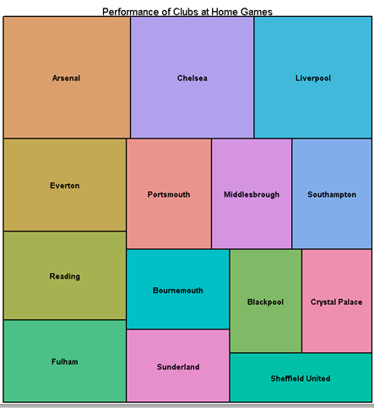
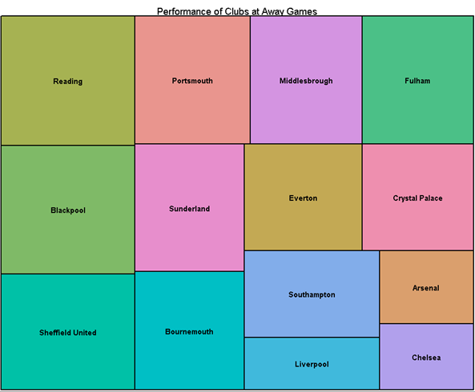
HOME-AWAY WIN PERCENTAGE

Slide 19
XML

Slide 20
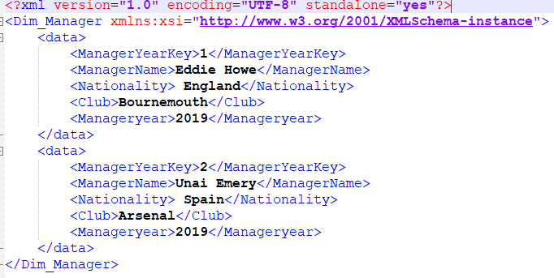
DIM-MANAGER
XML:

Slide 21
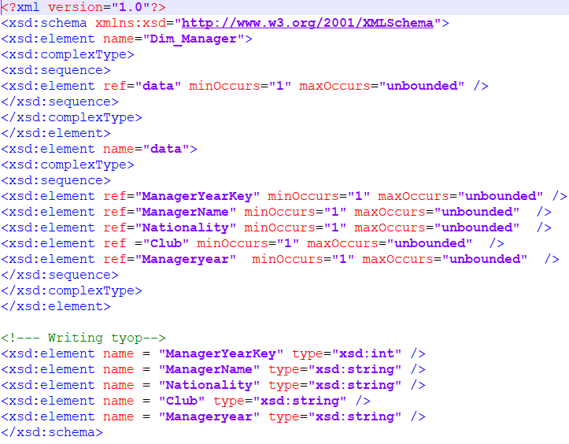
XSD:

Slide 22
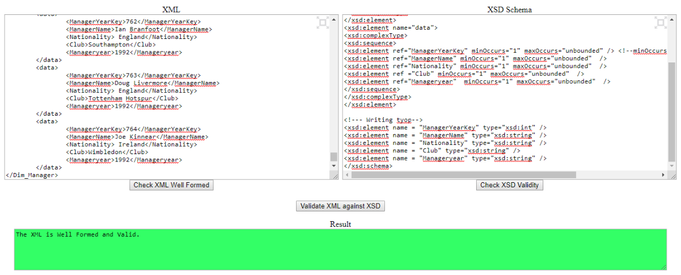
XSD & XML VALIDATION

Slide 23
NEO4J

Slide 24
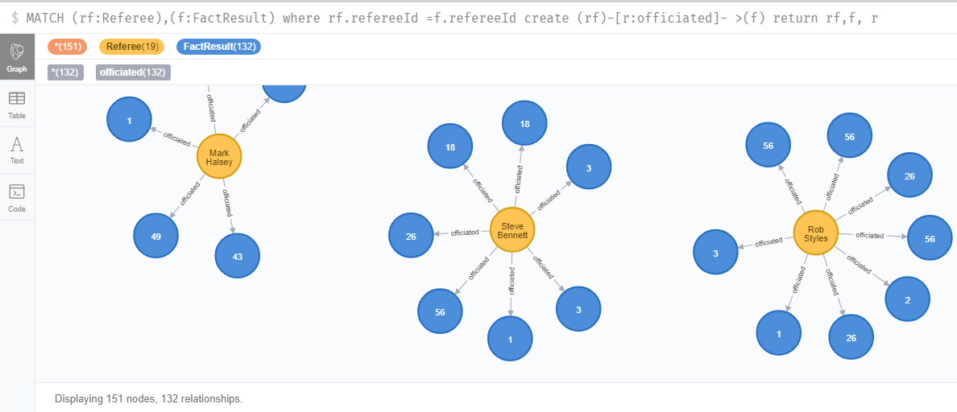
RELATIONSHIP REFEREE AND FACT RESULT

Slide 25
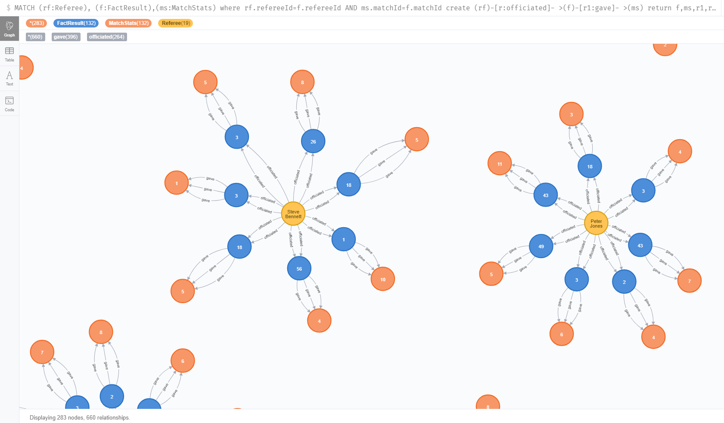
RELATIONSHIP BETWEEN REFEREE DIMENSION, FACT TABLE AND MATCH STATISTICS DIMENSION

Slide 26
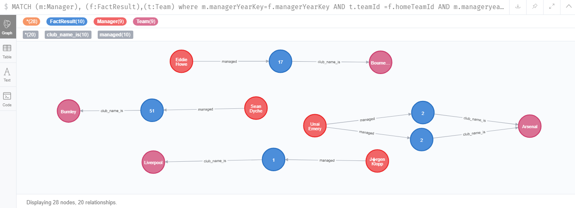
RELATIONSHIP BETWEEN MANAGER DIMENSION, FACT TABLE AND TEAM DIMENSION

Slide 27
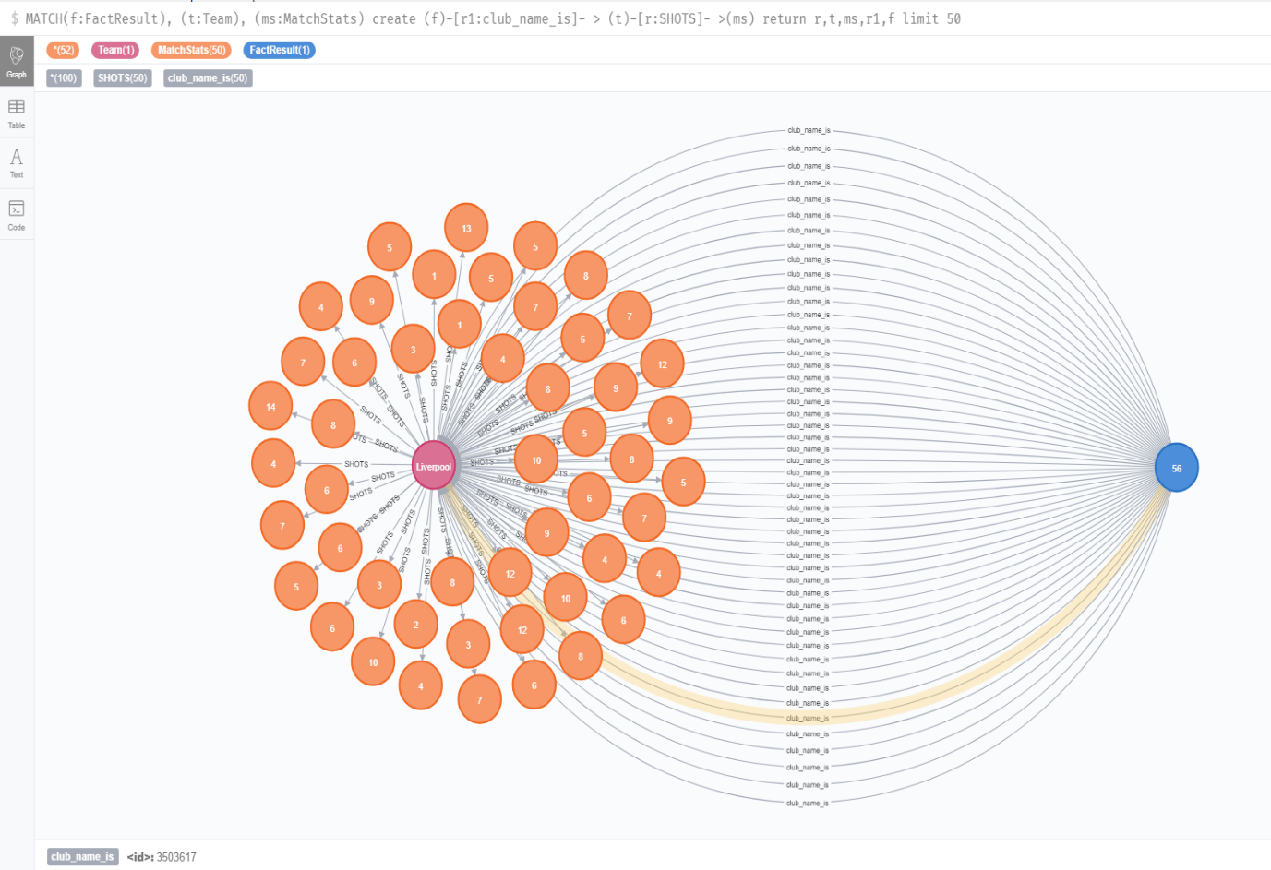
RELATIONSHIP BETWEEN TEAM DIMENSION, MATCH STATISTICS DIMENSION AND FACT TABLE

Slide 28
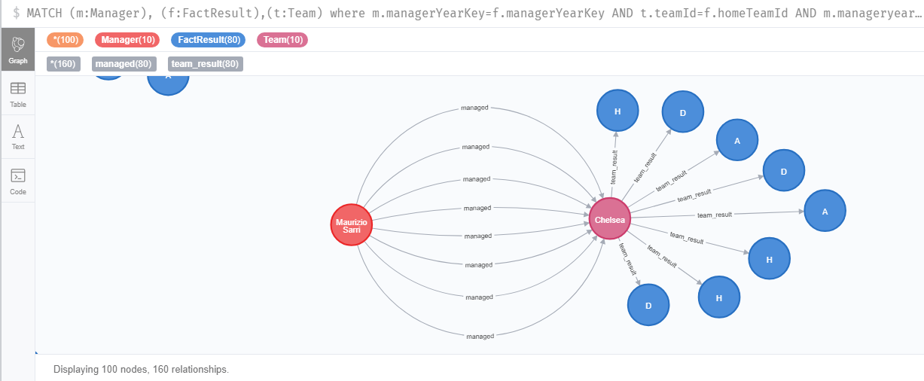
RELATIONSHIP BETWEEN MANAGER DIMENSION, FACT TABLE AND TEAM DIMENSION

Slide 29
STAKEHOLDERS
CLUBS / ACADEMIES / NATIONAL FEDERATIONS
BROADCASTERS
BETTING COMPANIES
SPONSORS

Slide 30
CONCLUSION

